Slide 1
Database Development Lifecycle
Reading Assignment:
Chapter 10: Database Development Lifecycle

Slide 2
Information system
The resources that enable the collection, management, control, and distribution of information throughout an organization.
A computer-based information system includes a database, database software, application software, computer hardware, and personnel using and developing the system.

Slide 3









Information system
The database is a fundamental component of an information system, and its development and usage should be viewed from the perspective of the wider requirements of the organization.

Slide 4



The Database System Development Lifecycle

Slide 5

Creating software without any formal guidelines or process
The later a problem is found in software, the more costly it is to fix.

Slide 6






Stages of DSDL
Database planning
System definition
Requirements collection
and analysis
Database design
DBMS selection (optional)
Application design
Prototyping (optional)
Implementation
Data conversion and loading
Testing
Operational maintenance

Slide 7


Stages of DSDL
Database Planning
The management activities that allow the stages of the database system development lifecycle to be realized as efficiently and effectively as possible.
identification of activity
evaluation of current information systems to determine existing strengths and weaknesses

Slide 8
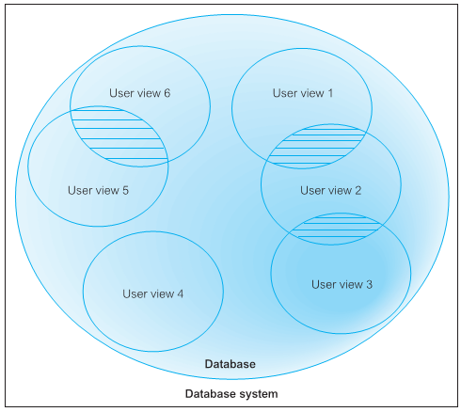





















Stages of DSDL
System Definition
Describes the scope and boundaries of the database application and the major user views.
User Views

Slide 9
Stages of DSDL
Requirements collection and analysis
The process of collecting and analyzing information about the part of the organization that is to be supported by the database system, and using this information to identify the requirements for the new system

Slide 10
Stages of DSDL
Requirements collection and analysis
Information is gathered for each major user view including:
a description of data used or generated
details of how data is to be used/generated
any additional requirements for new database system
Information is analyzed to identify requirements to be included in new database system. (Requirements specification)

Slide 11
Stages of DSDL
Requirements collection and analysis
Another important activity is deciding how to manage the requirements for a database system with multiple user views
Three main approaches:
centralized approach
view integration approach
combination of both approaches

Slide 12
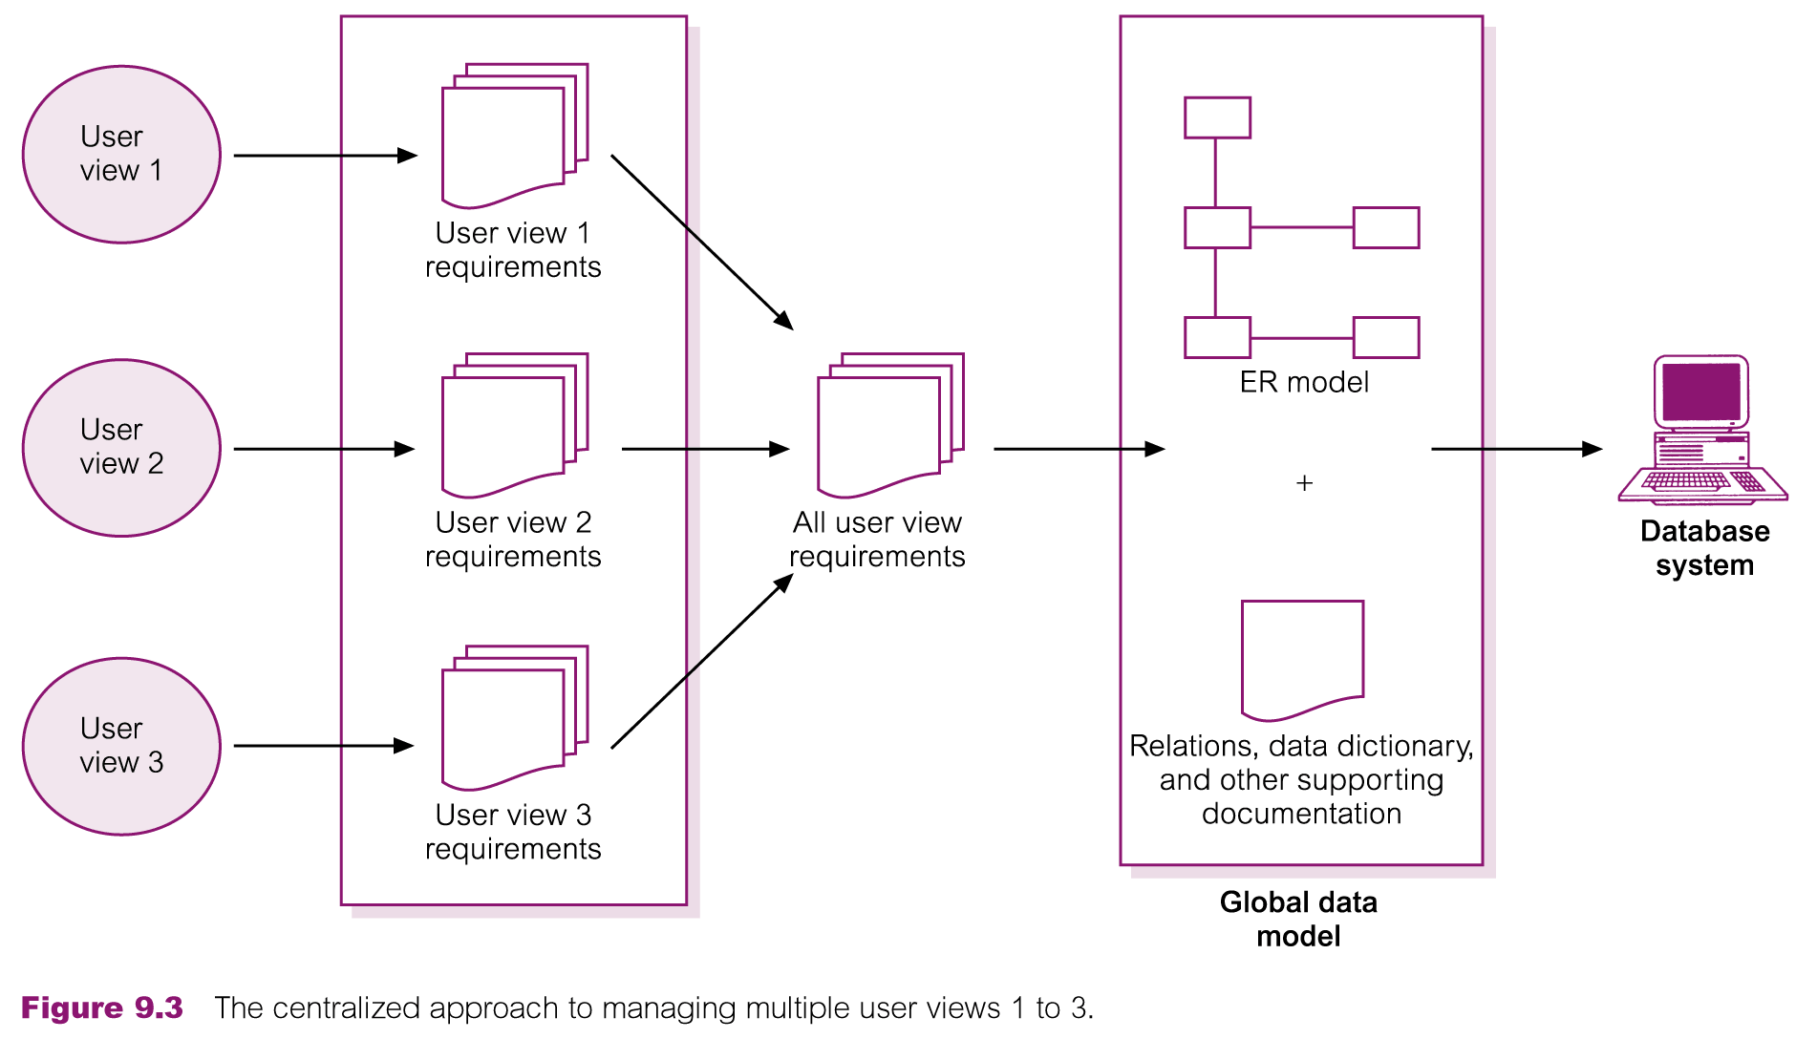
Centralized Approach
Requirements for each user view are merged into a single set of requirements for the new database system.
A data model representing all user views is created during the database design stage.

Slide 13
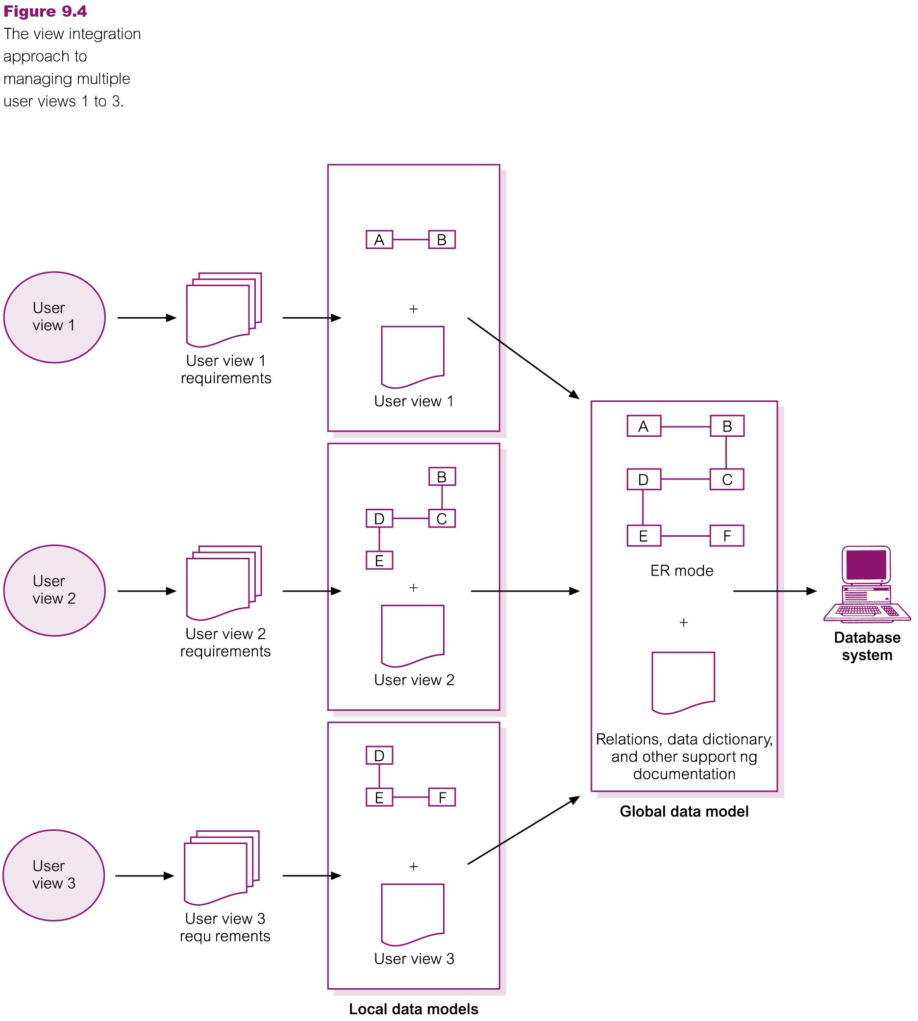













View Integration Approach

Slide 14
Stages of DSDL
Database Design
The process of creating a design that will support the enterprise’s design mission objectives for the required database system.

Slide 15
Stages of DSDL
Database Design
Main Approaches
Bottom-up Approaches
top-down Approaches
Inside-out
Mixed

Slide 16


Stages of DSDL
Database Design
Main purposes of data modeling include:
to assist in understanding the meaning (semantics) of the data;
to facilitate communication about the information requirements.
Building data model requires answering questions about entities, relationships, and attributes.

Slide 17















Stages of DSDL
Phases of database design
Conceptual database design
Logical database design
Physical database design.

Slide 18












Stages of DSDL (Phases of database design)
Conceptual database design
Process of constructing a model of the data used in an enterprise, independent of all physical considerations.
Data model is built using the information in users’ requirements specification.
Conceptual data model is source of information for logical design phase.

Slide 19
Stages of DSDL (Phases of database design)
Logical database design
Process of constructing a model of the data used in an enterprise based on a specific data model (e.g. relational), but independent of a particular DBMS and other physical considerations.
Conceptual data model is refined and mapped on to a logical data model.

Slide 20

Stages of DSDL (Phases of database design)
Physical database design
Process of producing a description of the database implementation on secondary storage.
Describes base relations, file organizations, and indexes used to achieve efficient access to data. Also describes any associated integrity constraints and security measures.
Tailored to a specific DBMS system.

Slide 21
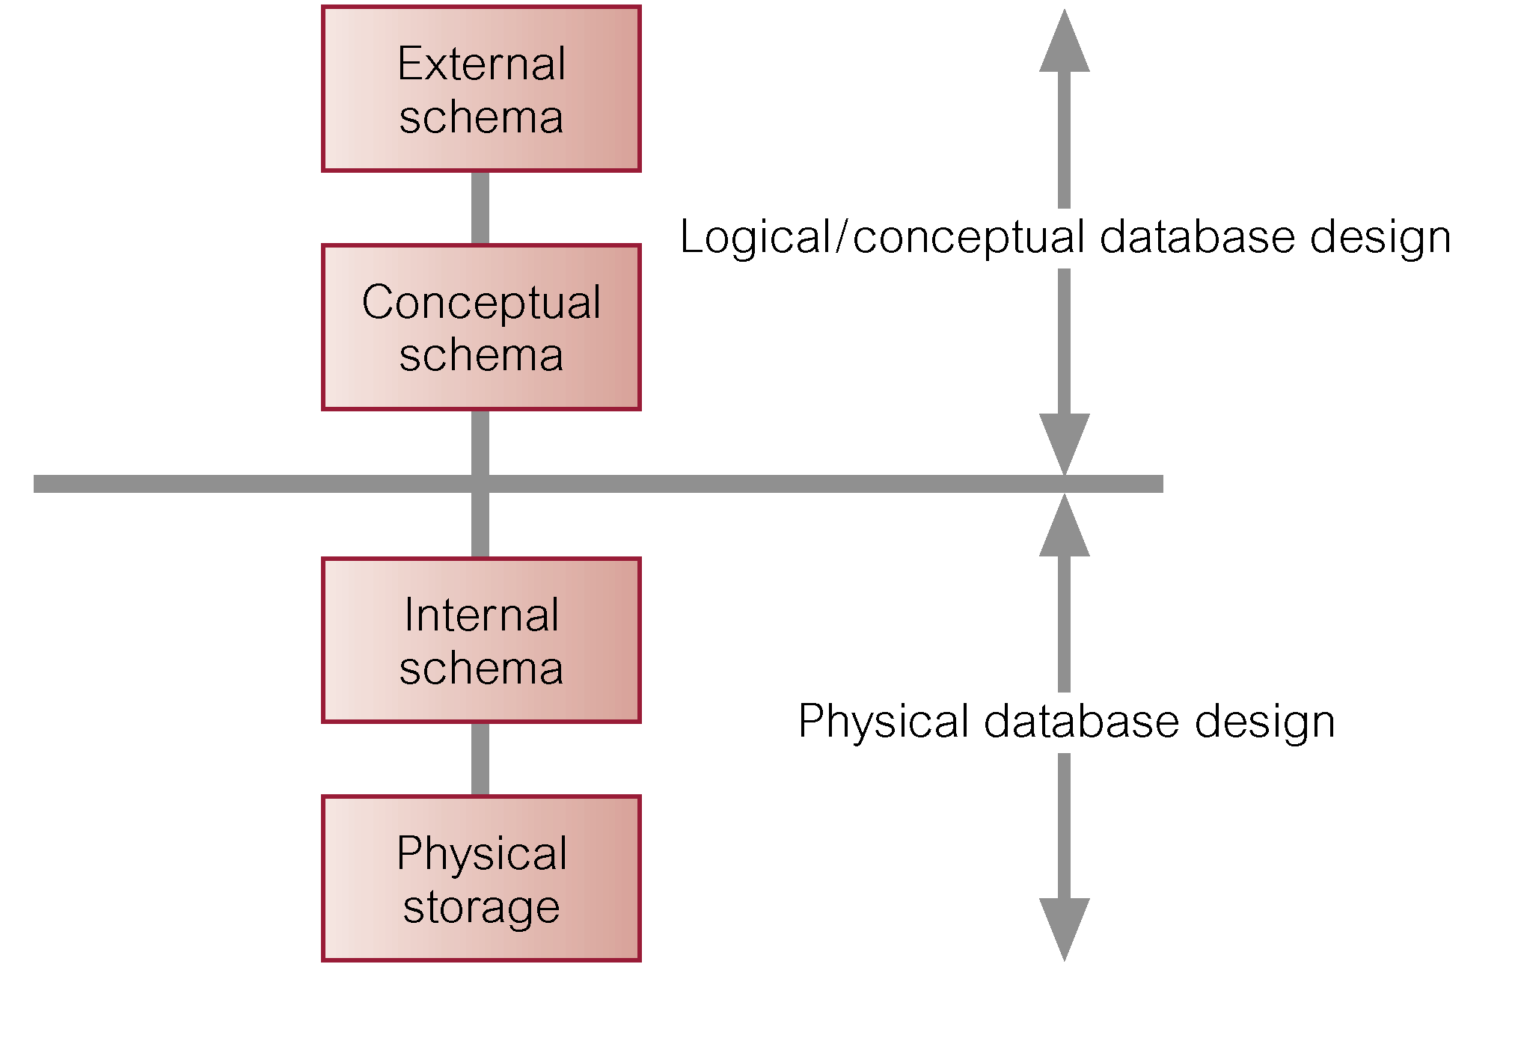
Stages of DSDL (Phases of database design)
Three-Level ANSI-SPARC Architecture and Phases of Database Design

Slide 22
Stages of DSDL
DBMS Selection
Selection of an appropriate DBMS to support the database system.
Undertaken at any time prior to logical design provided sufficient information is available regarding system requirements.

Slide 23
Stages of DSDL
Application Design
Design of user interface and application programs that use and process the database.
Database design and application design are parallel activities.
Includes two important activities:
transaction design
user interface design

Slide 24
Stages of DSDL Application Design
Transaction: An action, or series of actions, carried out by a single user or application program, which accesses or changes the content of the database.

Slide 25
Stages of DSDL
Prototyping: Building a working model of a database system. (Figure)
Implementation: The physical realization of the database and application designs. (DDL / DML)
Data conversion and loading: Transferring any existing data into the new database and converting any existing applications to run on the new database. (APPLICATION USE)
Testing: The process of running the database system with the intent of finding errors.
Operational Maintenance

Slide 26
Thank You

